Slide 1
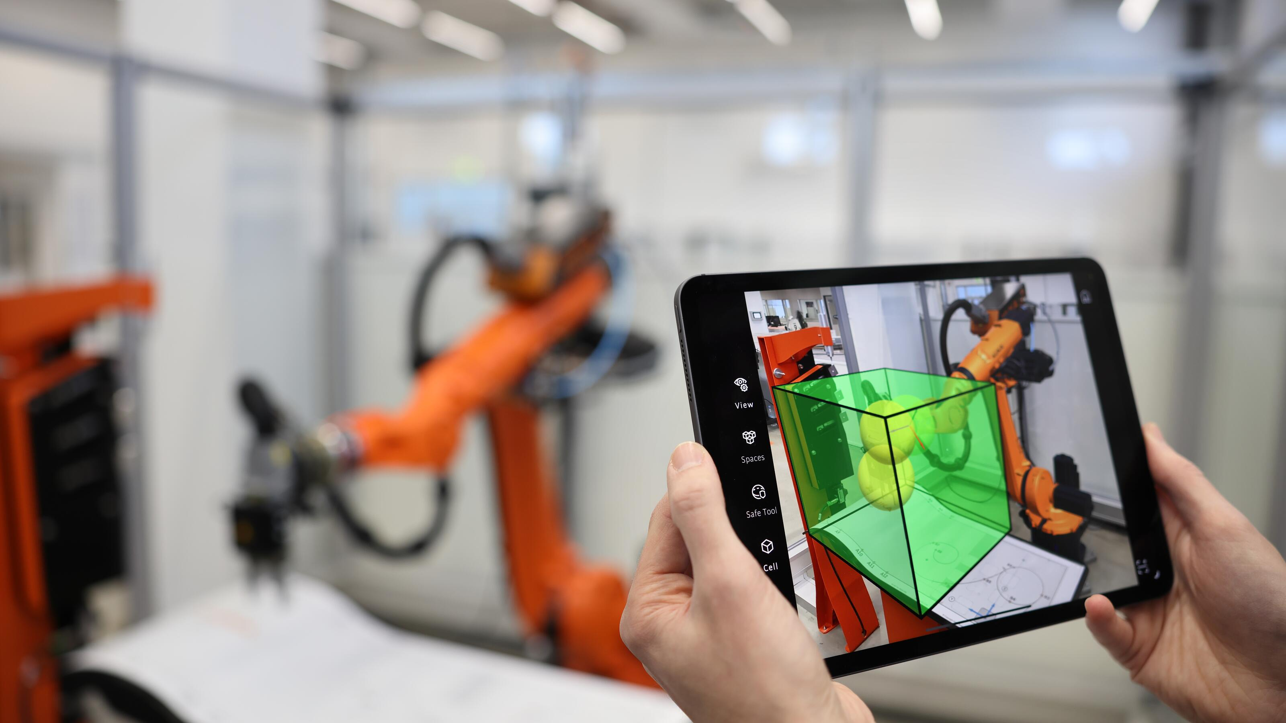
Adapting KUKA How KUKA can enter New Markets with Software-defined Products
Yang Zhang, Hiya Sharma, Sakshat Sawant, Vashisth Patel, Sebastian Delles
Picture: KUKA Group „Rob_KUKA.MixedReality_Image 4“

Slide 2
01
Introduction
05
Executive Summary
02
Competitor and Market Analysis
06
Appendix
03
Learnings from Software Firms and Competitors
04
Strategic Approach for entering New Markets

Slide 3
Introduction
01

Slide 4
Analyzing the problem to find the best solution for KUKA
Objective
Develop a strategy for KUKA to enter new markets with emphasis on software defined products
Customer cannot describe their problem or their need*
KUKA has already a lot of Software-defined Products
“People don’t know what they want until you show it to them.”**
Focus on existing products instead of developing new solutions
* Elmar Schauppel, paraphrased; ** Steve Jobs

Slide 5
Competitor and Market Analysis
02

Slide 6


The shift from Hardware to Software in Robotics has been significant in the recent years
Industry Trends
Increasing demand for integrated solutions
Growing importance of digitalization and Industry 4.0
Shift towards software-defined products
Benefits
Higher profit margins
Recurring revenue streams
Improved adaptability to market changes
Sources: T-Systems (2024)

Slide 7
Integrators play a major role in New Small Business’ Market.
Status Quo
They have expertise in specific field and are better equipped to solve specific consumer problems.
Ability of integrators highly affect the success and failure of the new entry strategy.
Certain challenges in the integrator-consumer relations which could become more apparent during the market entry in the new consumer segment.
Future Challenges
Limited understanding of the potential applications to new customers.
Difficulty for finding suitable integrators for clients.
Accurate description of the product requirements by consumers and regular communication with respect to the progress of the project.
Sources: Goto & Arakawa (2023)

Slide 8
The interviews provided a varied opinion about the various stakeholders of the Robotics industry.
HAI Robotics
Focus on Asian market
Sells mainly to integrators
Speed is prioritized over software quality.
Focus more on hardware because it is more profitability for them
Industry Insights
Lean optimizations and path planning are areas of interest in the robotics field.
Most medium-sized robotics companies do not focus heavily on marketing; instead, they rely more on reputation and PR activities.
The effectiveness of these efforts is uncertain because, in B2B sales, customers often buy from the salesperson rather than the product itself.
For large companies, data analytics is essential for understanding customer needs, while R&D companies need marketing mainly for attracting investments.
Universal Robots
Working towards textually conveying scenarios to the robots to make it learn on the job
AI-powered algorithms analyze data from sensors to enable robots to work in unstructured environments, such as moving assembly lines.

Slide 9
Learnings from Software Firms
and Competitors
03

Slide 10
Popular Strategies for Software-defined Products in Literature
Platforms and Ecosystems
Demand Chain
Digital Twin
„A platform is a business model that aims to facilitate value-creating interactions between external producers and consumers.“ (Molenaar, 2022, p. 4)
Enables interactions and reduces transaction-costs
Value increases with more users
Focus on the customers demand – not standardized products (“supply”)
Needs interaction and collaboration with different parties
Virtual replica of hardware-products
Bi-directional connectivity
Live data from device
Advantages:
Accelerates design-phase
Reduce errors
Optimize workflow & process
Sources: Azizi & Barenji (2023); Crespi (2023,); Hausberg et al. (2019); Hoe (2022); Mishra et al. (2024); Molenaar (2022); Perez Mengual (2023); Tao et al. (2019); Zhu et al. (2016)

Slide 11
There are 4 Common Business Models for Software Products
Sales (One-time purchase)
Subscription-based (SaaS)
Freemium
Volume Licensing
Traditional approach
Selling perpetual licenses for a one-time fee.
Modern software approach
Customers pay a recurring fee ➔ more predictable cash flows
Offering a free basic and a paid version
Difference in features
Attracts a large user base quickly
Charging based on the number of users or devices
B2B-Market
Enhanced Support
Examples (historically)
Windows OS
Microsoft Office
Examples
Microsoft 365
Adobe Creative Suite
Examples
Slack
Dropbox
Example
Microsoft Volume Licensing for enterprises
Sources: Farid (2024); Hussain (2024)

Slide 12





Strategic actions of successful Software-focus Companies.
Lessons for KUKA
Move from Single-Sale Purchases to SaaS
Lessons for KUKA
Focus on digital twin to simulate robotic operations and predict maintenance issues.
Lessons for KUKA
Develop a platform for remote diagnostics, predictive maintenance
Lessons for KUKA
Continuous software updates with new features and usability improvements
Lessons for KUKA
Build an ecosystem connecting different products and solutions.

Slide 13
Strategic Approach for entering New Markets
04

Slide 14
A 4-Step approach to enter New Markets and show the customer what they need.
Identify
New Markets
Low market penetration with robots
Face labor-shortage
Have repetitive and simple tasks (i.e. mostly untrained-workers are hired)
Connect
Knowledge
It is all about interdisciplinary
Robot experts and industry experts working together
Ask
Questions
Identify routine tasks and daily problems in workshops and discuss solutions
Identification of of processes with field observations
Deliver
Solutions
Holistic approach from KUKA to integrator with industry specific solutions

Slide 15
To find solutions for an industry you need an interdisciplinary team.
Identify New Markets
Connect Knowledge
Ask Questions
Deliver Solutions
Automation Experts
Industry Experts
KUKA
Project manager
Intern
KUKA Partner
Selected and reliable Integrator
Accessory manufacturer
Application developer
Industry
Individual and small chains
Guilds and chambers
Industry Partner
Manufacturer used devices and tools

Slide 16
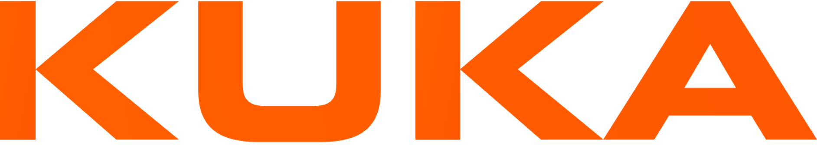
Understanding the tasks, processes of the customer is the fundament for a Holistic Solution.
Identify New Markets
Connect Knowledge
Ask Questions
Deliver Solutions
Workshops
Field Observations
Workshops
Identify routine tasks
Identify current problems
Show robots in a lab environment
Discuss how robots could help
Identify which process could be automated
Identify how viable solutions can look like
Explore product, tools and machines in use
+
Organized and moderated by

Slide 17
Do not act as a Robot company. Be an active stakeholder in the target market and show them what they need.
Identify New Markets
Connect Knowledge
Ask Questions
Deliver Solutions
From Project to Business
Solutions
Marketing
Project status to ongoing business unit
KUKA Markets (Industry Name)
Project manager continues as Unit manager
Stakeholder stay connected as Advisory Council
Best cases with focus on generic tasks in specific industry
Connecting with specialized
Integrator
Accessories
Developers
Manufacturer
Robot as a Service including renting
Attending industry specific conferences and trade shows
Workshops in conjunction with chambers and guilds
Publish articles in industry specific papers
Academic journals
Non-academic journals

Slide 18
An interdisciplinary approach brings advantages and benefits for every stakeholder.
Automation Experts
Industry Experts
KUKA
Growth with entering new markets
First mover advantage
Connecting with new partners in industry (exclusivity)
KUKA Partner
Enter new markets
Intensify connection with KUKA
Industry
Solution for labor shortages
Competitive advantages to other firms
Industry Partner
Added value trough symbiosis with KUKA

Slide 19
Executive Summary
05

Slide 20
Executive Summary
Problem and Solution
Problem
For further growth KUKA needs to enter new markets with its software-defined products.
Strategic Solution
Find new markets with low automation.
Connect people from automation and target industry.
Identify problems and routine task.
Develop together solutions and approaches in workshops and field observations.
Address target market with conferences, workshops and journals and deliver ongoing industry specific solutions with an advisory council.

Slide 21
Thank you for your attention

Slide 22
Appendix

Slide 23
Sources and Literature
Ameen, N., Tarhini, A., Reppel, A., & Anand, A. (2021). Customer experiences in the age of artificial intelligence. Computers in Human Behavior, 114, 106548. https://doi.org/10.1016/j.chb.2020.106548
AppDirect. (2024). ABB Creates Ecosystem of Digital Solutions—AppDirect. https://www.appdirect.com/customers/abb
Azizi, A., & Barenji, R. V. (Eds.). (2023). Industry 4.0: Technologies, Applications, and Challenges. Springer Nature Singapore. https://doi.org/10.1007/978-981-19-2012-7
Crespi, N., Drobot, A. T., & Minerva, R. (Eds.). (2023). The Digital Twin. Springer International Publishing. https://doi.org/10.1007/978-3-031-21343-4
Dinh, T. N., & Thai, M. T. (2018). AI and Blockchain: A Disruptive Integration. Computer, 51(9), 48–53. https://doi.org/10.1109/MC.2018.3620971
Farid, A. (2024, July 11). Evaluating 6 Common Software Business Models In 2024. https://upstackstudio.com/blog/software-business-models/
Goto, M., & Arakawa, M. (2023). Digital Platform for Improving Development Efficiency and Profitability of Robot System Integrators. In A. Khare & W. W. Baber (Eds.), Adopting and Adapting Innovation in Japan’s Digital Transformation (pp. 17–36). Springer Nature Singapore. https://doi.org/10.1007/978-981-99-0321-4_2
Hausberg, J. P., Liere-Netheler, K., Packmohr, S., Pakura, S., & Vogelsang, K. (2019). Research streams on digital transformation from a holistic business perspective: A systematic literature review and citation network analysis. Journal of Business Economics, 89(8–9), 931–963. https://doi.org/10.1007/s11573-019-00956-z
Hoe, S. L. (2022). Digital Transformation: Strategy, Execution, and Technology (1st ed.). Auerbach Publications. https://doi.org/10.1201/9781003311393
Hussain, A. A., & Al‐Turjman, F. (2021). Artificial intelligence and blockchain: A review. Transactions on Emerging Telecommunications Technologies, 32(9), e4268. https://doi.org/10.1002/ett.4268
Hussain, M. A. (2024). Top business models in the software industry, along with their frameworks and examples | LinkedIn. https://www.linkedin.com/pulse/top-business-models-software-industry-along-examples-hussain-1lahf/
KUKA. (2023). Artificial intelligence: How to train a neural network. KUKA AG. https://www.kuka.com/en-de/company/iimagazine/2023/08/micropsi-und-kuka
KUKA. (2024). KUKA’s mission: Automation and robotics for everyone. KUKA AG. https://www.kuka.com/en-de/future-production/kuka-mission-2030

Slide 24
Sources and Literature
Kulläng, R. (2024). From a Hardware-First to a Software-First Business. https://www.modularmanagement.com/blog/from-a-hardware-first-to-a-software-first-business
Kumar, V. (2023). Digital Platforms. In V. Kumar, The Economic Value of Digital Disruption (pp. 331–393). Springer Nature Singapore. https://doi.org/10.1007/978-981-19-8148-7_4
Laccourreye, O., & Maisonneuve, H. (2019). French scientific medical journals confronted by developments in medical writing and the transformation of the medical press. European Annals of Otorhinolaryngology, Head and Neck Diseases, 136(6), 475–480. https://doi.org/10.1016/j.anorl.2019.09.002
Mallikarjunaradhya, V., & Pothukuchi, A. S. (2021). The Future of SAAS Startups: How AI Accelerates Market Research and Product Development. Asian Journal of Multidisciplinary Research & Review, 2(4), 444–450.
Mishra, A., El Barachi, M., & Kumar, M. (Eds.). (2024). Transforming Industry using Digital Twin Technology. Springer Nature Switzerland. https://doi.org/10.1007/978-3-031-58523-4
Molenaar, C. (2022). Demand-driven business strategy: Digital transformation and business model innovation. Routledge.
Perez Mengual, M. (2023). Designing physical interaction platforms. Springer Gabler.
Saponaro, M., Le Gal, D., Gao, M., Guisiano, M., & Maniere, I. C. (2018). Challenges and Opportunities of Artificial Intelligence in the Fashion World. 2018 International Conference on Intelligent and Innovative Computing Applications (ICONIC), 1–5. https://doi.org/10.1109/ICONIC.2018.8601258
Tao, F., Zhang, M., & Nee, A. Y. C. (2019). Digital twin driven smart manufacturing. Academic press.
T-Systems. (2024). KUKA Edge Computing. https://www.t-systems.com/de/en/iot-and-edge/solutions/kuka-edge-computing
Univeral Robots. (2024). Release Notes 5.13.0. https://www.universal-robots.com/articles/ur/release-notes/release-note-software-version-513xx/
Zhu, X., Song, B., Ni, Y., Ren, Y., & Li, R. (2016). Prosumer Economy—From Supply Chain to Prosumer Economy. In X. Zhu, B. Song, Y. Ni, Y. Ren, & R. Li (Eds.), Business Trends in the Digital Era: Evolution of Theories and Applications (pp. 123–141). Springer Singapore. https://doi.org/10.1007/978-981-10-1079-8_7

Slide 25
Images
Slide 12
Logo of Microsoft Corporation.
Logo of Siemens AG
Logo of General Electric Company.
Logo of Tesla Inc.
Logo of Apple Inc.

Slide 26
Competitor Analysis in the robotic field - Sources
 | Kuka | Fanuc | ABB | Univeral Robots
Academy, eLearning, etc |  | https://www.fanuc-academy.de/ | https://new.abb.com/products/robotics/de/schulung | https://academy.universal-robots.com/de
Lifetime Management | https://www.kuka.com/de-de/services/my-kuka | https://www.fanuc.eu/de/de/lifetime-management | https://new.abb.com/products/robotics/de/service https://new.abb.com/products/robotics/de/service/nachr%C3%BCstung-modernisierung-upgrades
Overview Applications and Industries | https://www.kuka.com/de-de/branchen https://www.kuka.com/de-de/robot-guide | https://www.fanuc.eu/de/de/applikationen | https://new.abb.com/products/robotics/de/software-digitale-loesungen/applikationssoftware https://new.abb.com/products/robotics/de/applikationen https://new.abb.com/products/robotics/de/branchen | https://www.universal-robots.com/de/branchen/# https://www.universal-robots.com/de/branchen/
Best Cases | https://www.kuka.com/de-de/branchen/loesungsdatenbank | https://www.fanuc.eu/de/de/fallbeispiele-von-kunden |  | https://www.universal-robots.com/de/fallbeispiele/
Software Focus |  |  | https://new.abb.com/products/robotics/de/software-digitale-loesungen
VR, Simulation and non-Programming Generator |  |  | https://new.abb.com/products/robotics/de/robotstudio/robotstudio-desktop https://new.abb.com/products/robotics/de/software-digitale-loesungen/applikationssoftware/wizard | https://www.universal-robots.com/de/builder/
Monitoring and remote control solutions | https://www.kuka.com/de-de/services/my-kuka |  | https://new.abb.com/products/robotics/de/service/connected-services | https://myur.universal-robots.com/
Accessories Linked |  |  | https://new.abb.com/products/robotics/de/applikationsausruestung https://new.abb.com/products/robotics/de/applikationsausruestung/oekosystem
Forum |  |  |  | https://forum.universal-robots.com/
Sources: As of 2024-08-27. Links in the appendix.

